Slide 1
Smart Alarm System
TEAM MEMBERS:
Nurlan NogiBaev, Abdul Hakim, and Jahanzaib danish

Slide 2
contents
Introduction
Target Audience
Methodology and resources used
Challenges faced
Alternative approaches

Slide 3
Introduction
Alarm are used to alert an individual or group of individuals at a specified time.
Android based alarm system which will work in the following steps
User will set a remainder
Once time approaches, the buzzer will start
Upon clicking on stop button, A quiz will open
The application seek to complete a random quiz from the user
Upon successful completion of the quiz the alarm will stop

Slide 4

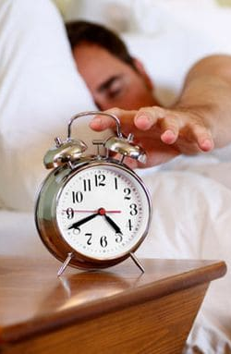
Target Audience
Usually, people find it hard to get off the bed in the morning
Just close/stop the alarm and then got to sleep again
Our app will force them to get off the bed to stop the alarm
People struggling to get off the bed especially in the morning

Slide 5
Methodology and Resources
Simple interface for users to set the alarm
Time picker for the user to select time
The alarm will start a tone, start buzzing upon approaching the set time
Created several quizzes based on basic general knowledge questions
The application will randomly choose some questions and the user need to give correct answers
When the user gives certain number of correct answers the alarm will stop

Slide 6
Challenges Faced
For notification, we made certain channel. Initially, it did not work because of the API level( needs to be grater than 29)
Machine learning merging part was quite challenging
Wasn’t able to connect ML to the rest of the application due to some problem with TensorFlow
Generated new Idea, and created the application

Slide 7
Alternative approaches
To use the actual idea of Machine Learning which we will keep working in future.
A simple alarm application can also be created with some options to choose tunes, and with some other features like stop watch, count down timer and so on.

Slide 8
The End! Any questions?

